Slide 1
Zoology Department Mata Jijabai Girls P. G college Indore
Paper 4th - Pisciculture and Economic importance of fishes
Types of pond required for fish culture

Slide 2
Synopsis
Introduction
Definition
Types of pond
Importance of site selection
Factors of site selection
Soil quality
Design of pond bottom
Pond dikes
Importance of dike
Outlet
Function of Outlet
Conclusion
References

Slide 14
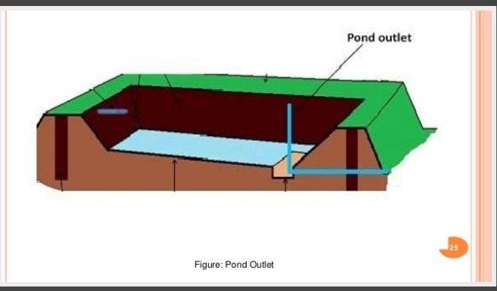

Slide 20
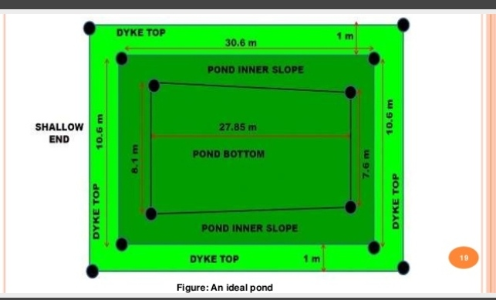

Slide 32
References
1. Fish and fisheries - S. K Khanna and H. R. Singh
2. Fish and fisheries - Kamlesh Panday and J. P Shukla

